Slide 1

Update on the commissioning
& Development of trics 8
MIKE GREEN, SURREY COUNTY COUNCIL
Notes:
In this presentation I am going to update you on the commissioning and development of TRICS 8. There has been some solid progress in the commission over the past few months, so I am pleased to provide some detail on this, along with a summary of some of the system improvements that this major upgrade of TRICS will deliver.

Slide 2


INTRODUCTION
THE TRICS 8 COMMISSION
TRICS 8 is a major redesign and upgrade which has been talked about for a few years now.
Today we present details of the commissioning of this project, which will see the TRICS system transformed both in terms of efficiency and user-friendliness, along with a range of new system features.
This project is being delivered at no additional cost to TRICS users.
Notes:
Firstly, a short introduction. TRICS Consortium Limited has talked about TRICS 8 for a few years now. The current series of system updates, TRICS 7, is now 11 years old, so we really are due this major systems overhaul and refresh. To design and deliver this new system we have been required to source and appoint a new systems developer, so I will briefly go into the commissioning of this project, which will see the TRICS system transformed both in terms of efficiency and user-friendliness, also touching upon some of the new features that will be introduced, and improvements to be made made to existing system functions. A key thing to also point out is that TRICS 8 is being delivered at no additional cost to TRICS users whilst adding further value to the system.

Slide 3


TRICS 8: THE KEY CHANGES & NEW FEATURES
A SUMMARY
Notes:
Let’s delve into the key changes that we will see in the set-up of the TRICS system for the TRICS 8 project. This will really be a major systems overhaul, with users seeing a whole new system at the end, but a system that keeps the core functions and principles of TRICS in place, albeit in a much-improved format and style.

Slide 4



TRICS 8: THE KEY POINTS
IMPROVED & ENHANCED SYSTEMS ARCHITECTURE
TRICS is being re-written from its current Delphi code to .NET Core C#.
New supporting software will enhance the system’s efficiency and user-friendliness.
A new Systems Developer is being commissioned.
A RANGE OF NEW SYSTEM FEATURES & IMPROVEMENTS
A comprehensive list of system improvements has accumulated.
Many improvements will be introduced as TRICS 8 is launched, with more to follow in subsequent system updates.
A MODERN DESIGN & IMPROVED USER INTERACTIONS
The look and feel of TRICS 8 will be significantly modernised and improved.
Users will be able to interact to a greater degree with the TRICS Licensing System.
Notes:
I can break the main points down into three sub-areas. Firstly, there will be improved and enhanced systems architecture. The programming language of Delphi, which is currently used for TRICS 7, has become somewhat aged, and research has shown that translating the system into the .NET Core C# language would be highly beneficial, allowing us to transform TRICS for a new era. This will be complemented by new supporting software add-ons and integration to improve the efficiency of the system. For this work, a new systems developer fully capable in such work is being commissioned. We then have the range of new system features and improvements, and a comprehensive list has built up over the past few years. Many of these improvements will be present when TYRICS 8 is launched, with others to be added as subsequent quarterly system updates continue to go live. An important thing to remember is that the system will have a much more modern design and improved user interactions. This will be evident from the outset with the new system’s look and feel, and the way that it is user-intuitive. Also, users will be able to interact more with the TRICS Licensing System, enhancing the efficiency and interaction between the two systems. Again, the feedback received from our users has been invaluable in this area.

Slide 5

NEW FEATURES
KEY IMPROVEMENTS
Notes:
I will now go through some of the key changes and new features that are being brought in for TRICS 8, which is being developed in two stages. Stage 1 is a like-for-like redesign and re-write of the TRICS 7 systems architecture, to allow for extensive comparative testing between TRICS 7 and TRICS 8, whilst Stage 2 will introduce the new and amended systems features to completed the initial project. This is not a list of all the new features. Instead, it is a summary of some key features.

Slide 6

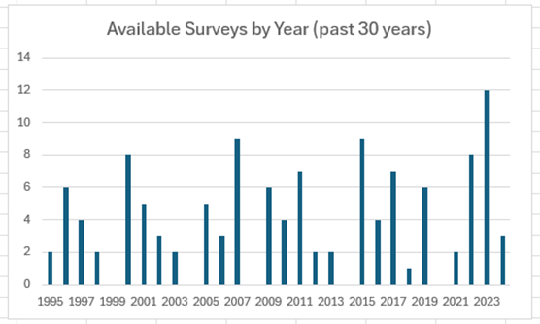
SOME NEW FEATURES OF TRICS 8
Default 8-year survey cut-off date removed and replaced with a graph of surveys available per year.
Improvements to the flow and efficiency of the trip rate calculation selection process.
Better interface with the TRICS Licensing System so that information about user organisations on PDF output headers becomes automated.
Notes:
Starting off, an important improvement is better flow and efficiency through the trip rate calculation selection (filtering) process. We are going to remove automatic resetting of selections when moving back and forth between the Primary and Secondary filtering stages, as well as removing the automatic resetting of selected date ranges. We will also be numbering the stages of filtering to indicate the most useful sequence of filtering activities, so in short, we are tweaking the process to improve its user-friendliness. We are also creating an improved interface between the database and the Licensing System to automate the information about user organisations that is shown on PDF report output headers. A significant change is the removal of the 8-year default cut-off date at the Primary filtering stage of the trip rate calculation selection process, with this being replaced by a graph of available surveys per year, to assist users in establishing their own start and end dates. This follows various technical analyses that TRICS have undertaken in recent years which have split data samples over time. The results obtained through these studies have led to the decision to remove the default cut-off period and replace iot with something much more useful and interactive.

Slide 7
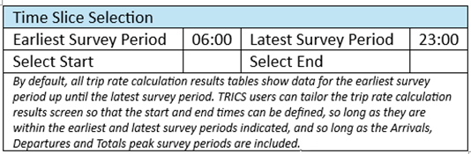
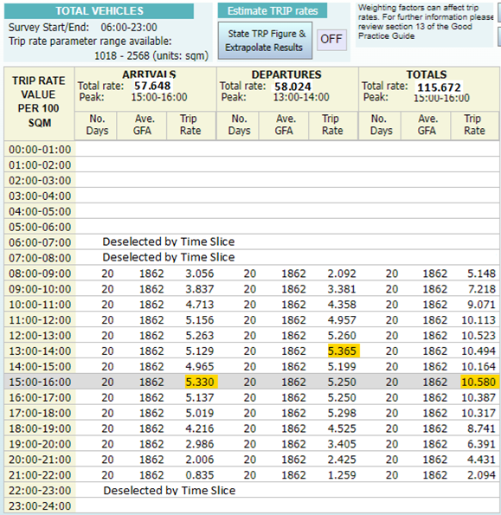
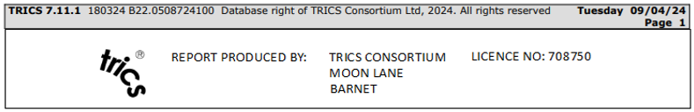
SOME NEW FEATURES OF TRICS 8
A “time slice” option where users can select start and end times for trip rate results tables.
Multiple deletes of previously saved (and no longer wanted) files to be made easier for users.
Improved design of PDF outputs to include the TRICS logo and the use of colour, plus improved headers.
Notes:
We will make it easier for older and no longer wanted reports saved by users to be deleted, and we will improve the design of PDF reports to include the TRICS logo and the display of clearer user information, whilst introducing the use of colour to generally modernise and improve the look and feel of these outputs. Another significant new feature will be the introduction of a “time slice” option when calculating and presenting trip rates. Using this new facility, users will be able to specify their start and end times for trip rate calculations, as shown in the example on this screen. Any periods outside of these start and end times will be highlighted with a “Deselected by Time Slice” message accordingly. This will be useful should users want to exclude earlier and later time periods where a very small number of surveys in the selected set might have count data available. So long as the peak periods (shown highlighted in yellow on this slide) are included, users will be able to focus their calculations in a more tailored way, should this be required on a case-by-case basis.

Slide 8
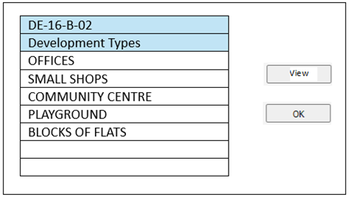
SOME NEW FEATURES OF TRICS 8
New pop-up note on timed-out user sessions added to all screens.
New pop-up note about external influencing factors added to the Primary Filtering stage.
Development types preview box for Mixed Used (16/B) sites.
Ability to move between the Members Area and the database without logging off.
Geographic Map facility extended so it is available within the Primary and Secondary trip rate calculation filtering stages.
Notes:
There will also be an improved ability for users to move between the Members Area of the TRICS website and the database without having to log off each time, this being another example of how we will make the system more efficient and user-friendly in more subtle yet effective ways. The Geographic Map facility, which embeds Google Maps into site lists, is going to be extended into the Primary and Secondary filtering stages of the trip rate calculation selection process, so that users can see their selected sites on maps in real time as they go through their selections. There will also be a couple of new pop-up guidance notes added. The first of these will be a note accessed via a button on all screens which explains timed-out user sessions and the fact that these are automatically saved (meaning users don’t lose their work should they be called away during a TRICS session). The second note will be some explanatory text on external influencing factors that can influence trip generation outside of the use of TRICS (referencing the TRICS Good Practice Guide), with this being available in the Primary filtering stage. Another new feature will be the introduction of development type preview boxes for each individual 16/B (Mixed Use) site in the database. Prior to accessing a site record, users will be able to view the preview to see what development types are present within mixed use sites in the database, which should make the process of assessing such sites more efficient.

Slide 9
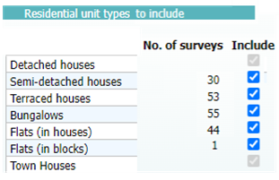
SOME NEW FEATURES OF TRICS 8
Minimum/Maximum survey date range to be stopped from resetting automatically.
Option to manually deselect surveys by region to be removed following clarification on research into regional and TRICS location type trip rate variation.
Improved quality and presentation of graphs and charts.
Width restrictions to be added to Local Traffic Calming Features section as a tick box option.
New dwelling unit type filtering option for residential land use sub-categories.
Notes:
In recent years we have enhanced the filtering process for 03 (Residential) land use sub-categories to include a range of new filtering options, and this will be taken further in TRICS 8 with the introduction of an option to filter by dwelling unit type (for example detached houses, semi-detached houses, bungalows, flats in blocks, etc). This new feature, which is shown in an example on this slide, will allow users to select which dwelling unit types they want to include in their selected set of surveys. This means that for all unticked unit types, all surveys that include such types will be excluded from the selected set, providing more fine-tuning capabilities for residential trip rate calculations, which remain the most popular with TRICS users overall. We will also prevent the minimum/maximum survey date range from being automatically reset when users change certain filtering options and following clarifications on trip rare variation by region compared to TRICS location type, we will be removing the option to deselect surveys automatically by region (we refer to our technical report on this which is freely available on the TRICS website). There will also be significant improvement on the design and presentation of the graphs and charts in the system, and we will add a new tick box option of width restrictions to the recently introduced Local Traffic Calming Features data section within individual site records.

Slide 10
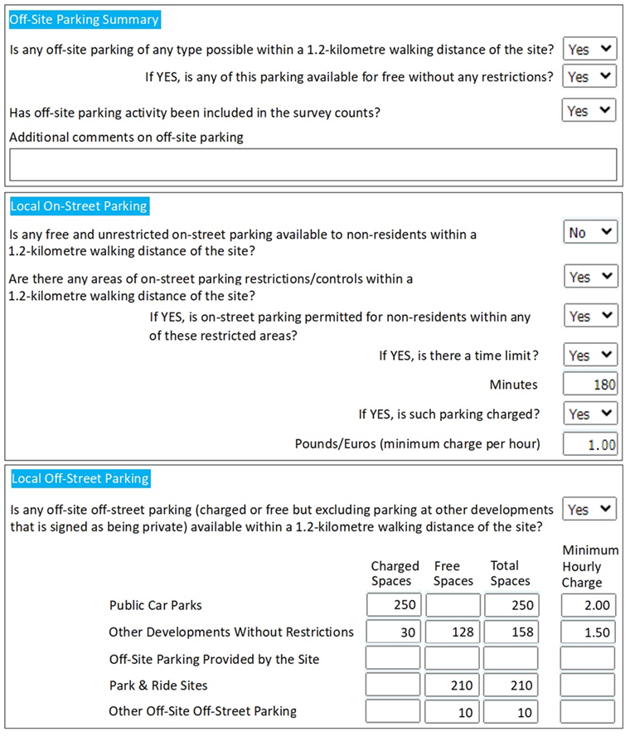
SOME NEW FEATURES OF TRICS 8
Full time-period options added for vehicle percentage and mode split pie charts within individual site records.
Improved clarity, structure and data fields for the Off-Site Parking data section.
Notes:
The vehicle percentage and mode split pie charts within individual survey records will be enhanced so that users can specify time periods and direction of flow, in the same way as they can with mode split pie charts for selected data sets once a multi-modal trip rate calculation has taken place. One big change is the improved clarity, structure and data fields for the Off-Site Parking data section for individual site records, with an example of the new format shown on this slide. This sub-section of data has been redesigned for all future sites entering the database so that both on-street and off-street parking outside of a surveyed development is much clearer and straightforward, whilst continuing to provide valuable data. The current Off-Site Parking section has become somewhat subjective and potentially confusing in some areas, so the new format will be a considerable improvement. Note that all existing sites in the database will remain unchanged, so the new format will only apply to new data being introduced into TRICS 8.

Slide 11
TRICS 8: THE COMMISSIONING PROCESS
A SUMMARY
Notes:
Having provided a quick summary of the key changes for TRICS 8, I would now like to say a few words about the TRICS 8 commissioning process. A lot of work has already gone into this process, and I can present a summary here.

Slide 12
THE COMMISSIONING PROCESS
SOURCING POTENTIAL DEVELOPERS
An initial search for potential new developers took place late in 2023.
A shortlist of developers took part in a pre-qualification process.
THE TENDERING PROCESS
A tender document was produced and was forwarded to candidate organisations in May 2024.
Presentations were given to the TRICS 8 Assessment Panel by candidate organisations near the end of the process.
ASSESSING TENDERS & THE AWARD
The Assessment Panel will meet to decide on the preferred systems developer early in July 2024.
The TRICS 8 commission will be awarded, and a contract agreed and signed, with work due to commence in August 2024.
Notes:
There are three distinct stages of the TRICS 8 commissioning process. Firstly, we needed to source potential developers. An initial search took place late in 2023, which involved advertising via our social media outlets and via our email contacts. Having had initial communications with numerous companies, a shortlist was put together, with candidate organisations then going through a pre-qualification process. This was followed by the writing of the TYRICS 8 tender document (which is quite sizeable as you might imagine), and this was forwarded to candidate organisations in May 2024, commencing the tendering period. In June 2024, nearing the end of the tendering period, presentations on the candidate organisations’ vision for TRICS 8 were given to the TRICS 8 Assessment Panel, to add extra context to the tender submissions. In July 2024, the Assessment Panel will meet to decide on the preferred systems developer for TRICS 8, and the TRICS 8 commission will then be awarded. Work is due to commence on Stage 1 of the new system in August 2024.

Slide 13
TRICS 8 DEVELOPMENT timeline
TRICS 8 STAGE 1 |  |  |  |  |  | TRICS 8 STAGE 2
 | AUG 2024 |  |  | JAN 2025 |  |  | MAR 2025 |  |  | JUN 2025
STAGE 1 COMMENCES Work starts on the conversion of the TRICS 7 code to the TRICS 8 code in a like-for-like format. |  |  | STAGE 1 TESTING Stage 1 is tested by the developer and the TRICS Team, with debugging taking place. |  |  | STAGE 2 COMMENCES New system features are developed. |  |  | STAGE 2 TESTING Stage 2 is tested by the developer and the TRICS team, with debugging taking place.
Notes:
Here is a timeline for the development of Stage 1 and Stage 2 of TRICS 8. Remember that Stage 1 is the like-for like translation of TRICS 7 into TRICS 8 using the C# programming language, whilst Stage 2 will introduce the new features and improvements outlined in this presentation. It is uncertain if the first live version of TRICS 8 will happen following the completion of Stage 1 or whether we will wait for the completion of Stage 2, so please bear this in mind, as a live version of Stage 1 will mean an earlier release date than the current official plan. Work on Stage 1 will commence in August 2024, with testing of this first phase starting in January 2025. Both the systems developer and the TRICS team will be involved in different elements of this testing, and after debugging is complete, work will commence on Stage 2 in March 2025. Testing of Stage 2 will take place from June 2025, again involving both the systems developer and the TRICS team.

Slide 14
WATCH THIS SPACE!
TRICS 8 IS SCHEDULED TO GO LIVE TO THE TRICS COMMUNITY IN SEPTEMBER 2025.
CAVEAT: THERE MAY BE AN INITIAL RELEASE OF STAGE 1 EARLIER THAN THIS,
BUT THIS IS TO BE DISCUSSED WITH THE DEVELOPER.
Notes:
Bearing in mind the caveat regarding a potential live release following the completion of Stage 1, TRICS 8 is currently scheduled to go live to the TRICS Community in September 2025. TRICS will of course keep everyone updated through our email, website and social media channels, so please watch this space. We are very pleased to finally get this commission underway, and we look forward to bringing all our users the great benefits of the new and improved TRICS 8, which will continue our ever-evolving TRICS system’s journey into a new era of development and innovation.

